Slide 1
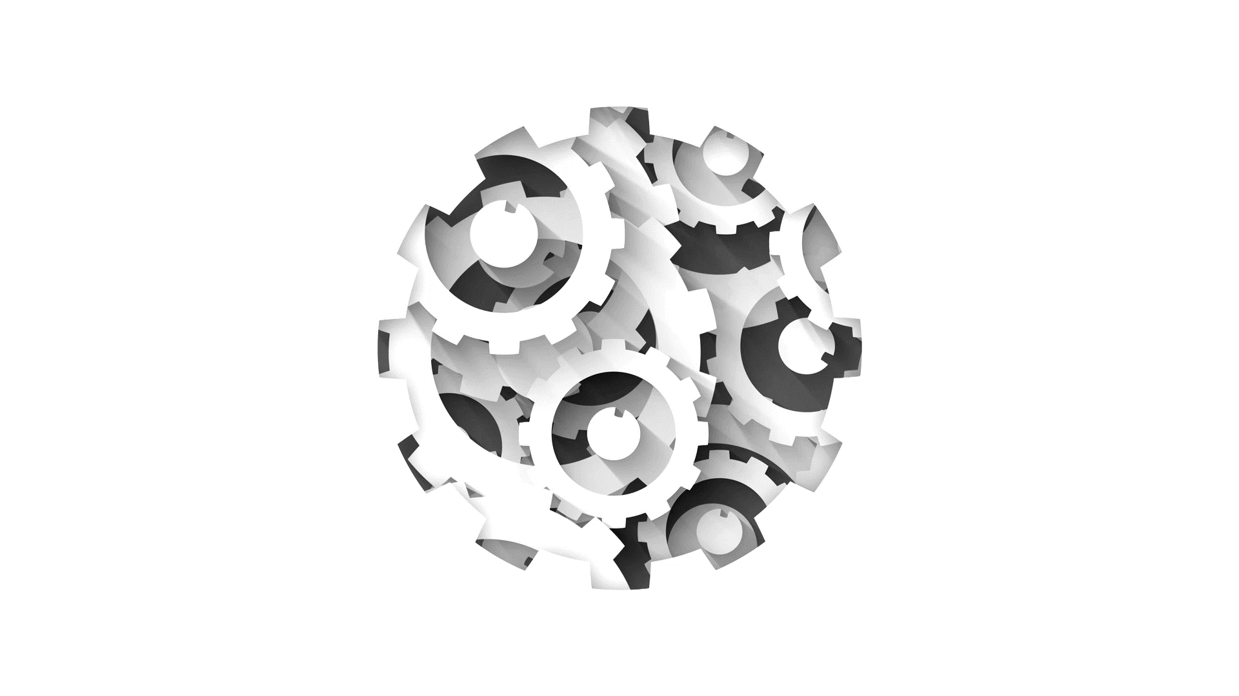


Software Engineering CS411, FALL 2025
System Testing and Exploratory Testing by Dr. Mohamad Kassab
Leonidas Kontothanassis. kthanasi@bu.edu

Slide 2
Agenda
Hacking
Overview of the “Taxonomy of System Testing”.
Overview of “Exploratory Testing”.

Slide 3
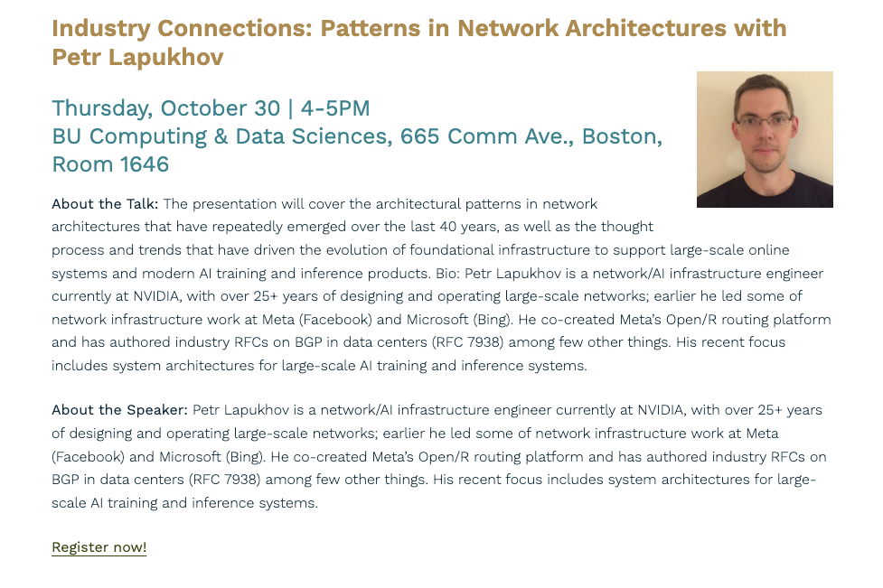
https://www.bu.edu/cds-faculty/2024/03/25/announcing-industry-connections-speaker-series/

Slide 4
Exploits…
Demo
https://exploit.education/phoenix/stack-five/
https://n1ght-w0lf.github.io/binary%20exploitation/stack-five/
https://shell-storm.org/shellcode/files/shellcode-909.html

Slide 5
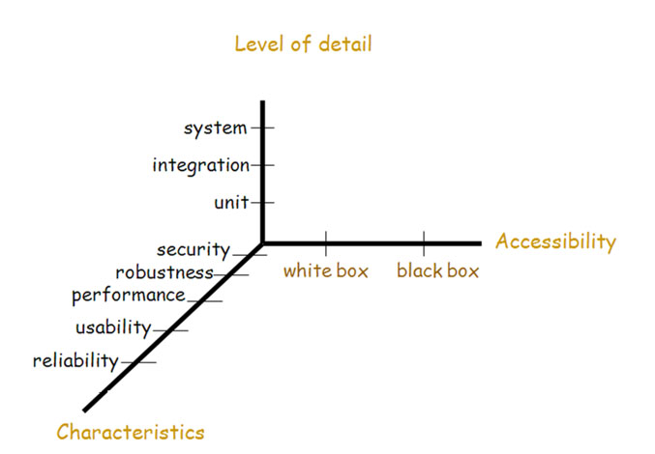
Testing Dimensions

Slide 6
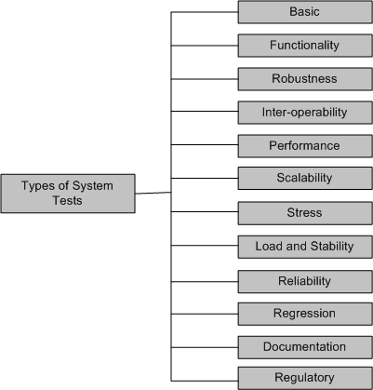
Taxonomy of System Tests
Types of system tests

Slide 7
Taxonomy of System Tests
Basic tests provide an evidence that the system can be installed, configured and be brought to an operational state
Functionality tests provide comprehensive testing over the full range of the requirements, within the capabilities of the system
Robustness tests determine how well the system recovers from various input errors and other failure situations
Inter-operability tests determine whether the system can inter-operate with other third party products
Performance tests measure the performance characteristics of the system, e.g., throughput and response time, under various conditions
Scalability tests determine the scaling limits of the system, in terms of user scaling, geographic scaling, and resource scaling

Slide 8
Taxonomy of System Tests
Stress tests put a system under stress in order to determine the limitations of a system and, when it fails, to determine the manner in which the failure occurs
Load and Stability tests provide evidence that the system remains stable for a long period of time under full load
Reliability tests measure the ability of the system to keep operating for a long time without developing failures
Regression tests determine that the system remains stable as it cycles through the integration of other subsystems and through maintenance tasks
Documentation tests ensure that the system’s user guides are accurate and usable
Regulatory/Compliance tests ensure that the system adheres to laws, standards, and regulations.

Slide 9
Taxonomy of System Tests
Types of system tests

Slide 10
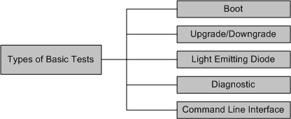
Basic Tests
Types of basic tests
Boot: Boot tests are designed to verify that the system can boot up its software image (or, build) from the supported boot options
Upgrade/Downgrade: Upgrade/downgrade tests are designed to verify that the system software can be upgraded or downgraded (rollback) in a graceful manner

Slide 11
Basic Tests
Light Emitting Diode: The LED (Light Emitting Diode) tests are designed to verify that the system LED status indicators functioning as desired
Diagnostic: Diagnostic tests are designed to verify that the hardware components (or, modules) of the system are functioning as desired
Power-On Self Test
Ethernet Loop Back Test
Bit Error Test
Command line Interface: Command Line Interface (CLI) tests are designed to verify that the system can be configured

Slide 12
Taxonomy of System Tests
Types of system tests

Slide 13
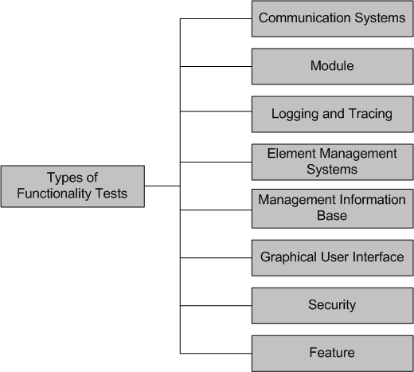
Functionality Tests
Types of functionality tests

Slide 14
Functionality Tests
Communication Systems Tests
These tests are designed to verify the implementation of the communication systems as specified in the customer requirements specification
Module Tests
Module Tests are designed to verify that all the modules function individually as desired within the systems
The idea here is to ensure that individual modules function correctly within the whole system.
For example, an Internet router contains modules such as line cards, system controller, power supply, and fan tray. Tests are designed to verify each of the functionalities

Slide 15
Functionality Tests
Logging and Tracing Tests
Logging and Tracing Tests are designed to verify the configurations and operations of logging and tracing
This also includes verification of “flight data recorder: non-volatile Flash memory” logs when the system crashes

Slide 16
Functionality Tests
Graphical User Interface Tests
Tests are designed to look-and-feel the interface to the users of an application system
Tests are designed to verify different components such as icons, menu bars, dialog boxes, scroll bars, list boxes, and radio buttons
The GUI can be utilized to test the functionality behind the interface, such as accurate response to database queries
Tests the usefulness of the on-line help, error messages, tutorials, and user manuals
The usability characteristics of the GUI is tested, which includes the following
Accessibility: Can users enter, navigate, and exit with relative ease?
Responsiveness: Can users do what they want and when they want in a way that is clear?
Efficiency: Can users do what they want to with minimum number of steps and time?
Comprehensibility: Do users understand the product structure with a minimum amount of effort?

Slide 17
Functionality Tests
Security Tests
Security tests are designed to verify that the system meets the security requirements
Confidentiality
It is the requirement that data and the processes be protected from unauthorized disclosure
Integrity
It is the requirement that data and process be protected from unauthorized modification
Availability
It is the requirement that data and processes be protected form the denial of service to authorized users
Security test scenarios should include negative scenarios such as misuse and abuse of the software system

Slide 18
Functionality Tests
Security Tests (cont’d) : useful types of security tests includes the following:
Verify that only authorized accesses to the system are permitted
Verify the correctness of both encryption and decryption algorithms for systems where data/messages are encoded.
Verify that illegal reading of files, to which the perpetrator is not authorized, is not allowed
Ensure that virus checkers prevent or curtail entry of viruses into the system
Ensure that the system is available to authorized users when a zero-day attack occurs
Try to identify any “backdoors” in the system usually left open by the software developers

Slide 19
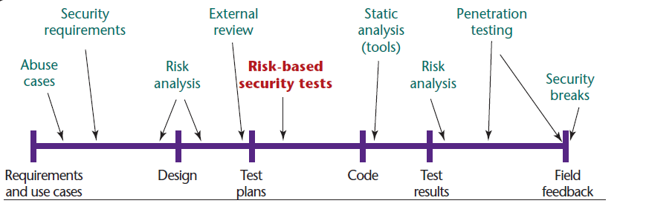
Security Testing Life Cycle
Bruce Potter and Gary McGraw, “Software Security Testing,” Security & Privacy, Sept/Oct 2004, pp. 32-36.

Slide 20
Software Security Testing Tasks
creating security abuse/misuse cases
listing normative security requirements
performing architectural risk analysis
building risk-based security test plans
wielding static analysis tools
performing security tests
performing penetration testing in the final environment
cleaning up after security breaches.
Bruce Potter and Gary McGraw, “Software Security Testing,” Security & Privacy, Sept/Oct 2004, pp. 32-36.

Slide 21
STRIDE
Microsoft approach security testing.
Involves subjecting the software to a set of known security attacks, defined by the acronym:
Spoofing identity
Tampering with data.
Repudiation.
Information disclosure
Denial of service.
Elevation of privilege
https://learn.microsoft.com/en-us/azure/security/develop/threat-modeling-tool

Slide 22
STRIDE
Spoofing identity
Example: illegally accessing and then using another user's authentication information, such as username and password
Spoofing email addresses is a common social engineering attack
https://learn.microsoft.com/en-us/azure/security/develop/threat-modeling-tool

Slide 23
STRIDE
Tampering with data
Involves the malicious modification of data
Examples
unauthorized changes made to persistent data, such as that held in a database
alteration of data as it flows between two computers over an open network, such as the Internet.
https://learn.microsoft.com/en-us/azure/security/develop/threat-modeling-tool

Slide 24
STRIDE
Plausible deniability
Repudiation.
threats associated with users who deny performing an action without other parties having any way to prove otherwise—
Example, a user performs an illegal operation in a system that lacks the ability to trace the prohibited operations.
Nonrepudiation
refers to the ability of a system to counter repudiation threats.
Example, a user who purchases an item might have to sign for the item upon receipt. The vendor can then use the signed receipt as evidence that the user did receive the package.
https://learn.microsoft.com/en-us/azure/security/develop/threat-modeling-tool

Slide 25
STRIDE
Information disclosure.
threats involve the exposure of information to individuals who are not supposed to have access
Example: the ability of users to read a file that they were not granted access to, or the ability of an intruder to read data in transit between two computers.
https://learn.microsoft.com/en-us/azure/security/develop/threat-modeling-tool

Slide 26
STRIDE
Elevation of privilege.
an unprivileged user gains privileged access and thereby has sufficient access to compromise or destroy the entire system.
Include those situations in which an attacker has effectively penetrated all system defenses and become part of the trusted system itself, a dangerous situation indeed.
https://learn.microsoft.com/en-us/azure/security/develop/threat-modeling-tool

Slide 27
Functionality Tests
Feature Tests
These tests are designed to verify any additional functionalities which are defined in requirement specification but not covered in the functional category discussed
Examples
Data conversion testing
Cross-functionality testing

Slide 28
Taxonomy of System Tests
Types of system tests

Slide 29
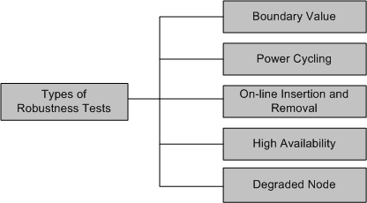
Robustness Tests
Robustness means how much sensitive a system is to erroneous input and changes its operational environment
Tests in this category are designed to verify how gracefully the system behaves in error situations and in a changed operational environment
Types of robustness tests

Slide 30
Robustness Tests
Boundary value
Boundary value tests are designed to cover boundary conditions, special values, and system defaults
The tests include providing invalid input data to the system and observing how the system reacts to the invalid input.
Power cycling
Power cycling tests are executed to ensure that, when there is a power glitch in a deployment environment, the system can recover from the glitch to be back in normal operation after power is restored
On-line insertion and removal
On-line Insertion and Removal (OIR) tests are designed to ensure that on-line insertion and removal of modules, incurred during both idle and heavy load operations, are gracefully handled and recovered

Slide 31
Robustness Tests
High Availability
The concept of high availability is also known as fault tolerance
High availability tests are designed to verify the redundancy of individual modules, including the software that controls these modules.
The goal is to verify that the system gracefully and quickly recovers from hardware and software failures without adversely impacting the operation of the system
High availability is realized by means of proactive methods to maximize service up-time, and to minimize the downtime
Degraded Node
Degraded node (also known as failure containment) tests verify the operation of a system after a portion of the system becomes non-operational
It is a useful test for all mission-critical applications.

Slide 32
Taxonomy of System Tests
Types of system tests

Slide 33
Interoperability Tests
Tests are designed to verify the ability of the system to inter-operate with third party products
The re-configuration activities during interoperability tests is known as configuration testing
Another kind of inter-operability tests is called (backward) compatibility tests
Compatibility tests verify that the system works the same way across different platforms, operating systems, data base management systems
Backward compatibility tests verify that the current software build flawlessly works with older version of platforms

Slide 34
Taxonomy of System Tests
Types of system tests

Slide 35
Performance Tests
Tests are designed to determine the performance of the actual system compared to the expected one
Tests are designed to verify response time, execution time, throughput, resource utilization and traffic rate
One needs to be clear about the specific data to be captured in order to evaluate performance metrics.
For example, if the objective is to evaluate the response time, then one needs to capture
End-to-end response time (as seen by external user)
CPU time
Network connection time
Database access time
Network connection time
Waiting time

Slide 36
Taxonomy of System Tests
Types of system tests

Slide 37
Scalability Tests
Tests are designed to verify that the system can scale up to its engineering limits
Scaling tests are conducted to ensure that the system response time remains the same, or increases by a small amount, as the number of users are increased.
There are three major causes of these limitations:
data storage limitations
network bandwidth limitations
speed limit
Extrapolation is often used to predict the limit of scalability

Slide 38
Taxonomy of System Tests
Types of system tests

Slide 39
Stress Tests
The goal of stress testing is to evaluate and determine the behavior of a software component while the offered load is in excess of its designed capacity
The system is deliberately stressed by pushing it to and beyond its specified limits
It ensures that the system can perform acceptably under worst-case conditions, under an expected peak load. If the limit is exceeded and the system does fail, then the recovery mechanism should be invoked
Stress tests are targeted to bring out the problems associated with one or more of the following:
Memory leak
Buffer allocation and memory carving

Slide 40
Taxonomy of System Tests
Types of system tests

Slide 41
Load and Stability Tests
Tests are designed to ensure that the system remains stable for a long period of time under full load
When a large number of users are introduced and applications that run for months without restarting, a number of problems are likely to occur:
the system slows down
the system encounters functionality problems
the system crashes altogether
Load and stability testing typically involves exercising the system with virtual users and measuring the performance to verify whether the system can support the anticipated load
This kind of testing help one to understand the ways the system will fare in real-life situations

Slide 42
Taxonomy of System Tests
Types of system tests

Slide 43
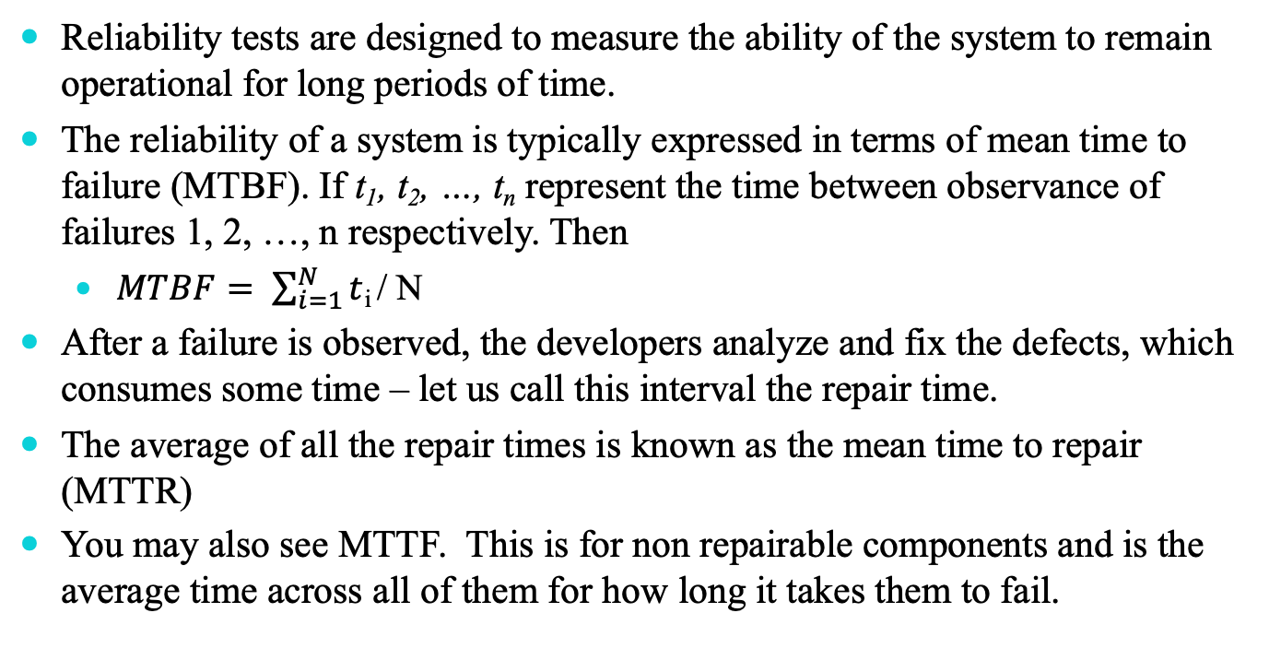
Reliability Tests
Reliability tests are designed to measure the ability of the system to remain operational for long periods of time.
The reliability of a system is typically expressed in terms of mean time to failure (MTBF). If t₁, t₂, …, t_{n} represent the time between observance of failures 1, 2, …, n respectively. Then
$MTBF= \sum_{i=1}^{N}{t}$_{i} / N
After a failure is observed, the developers analyze and fix the defects, which consumes some time – let us call this interval the repair time.
The average of all the repair times is known as the mean time to repair (MTTR)
You may also see MTTF. This is for non repairable components and is the average time across all of them for how long it takes them to fail.

Slide 44
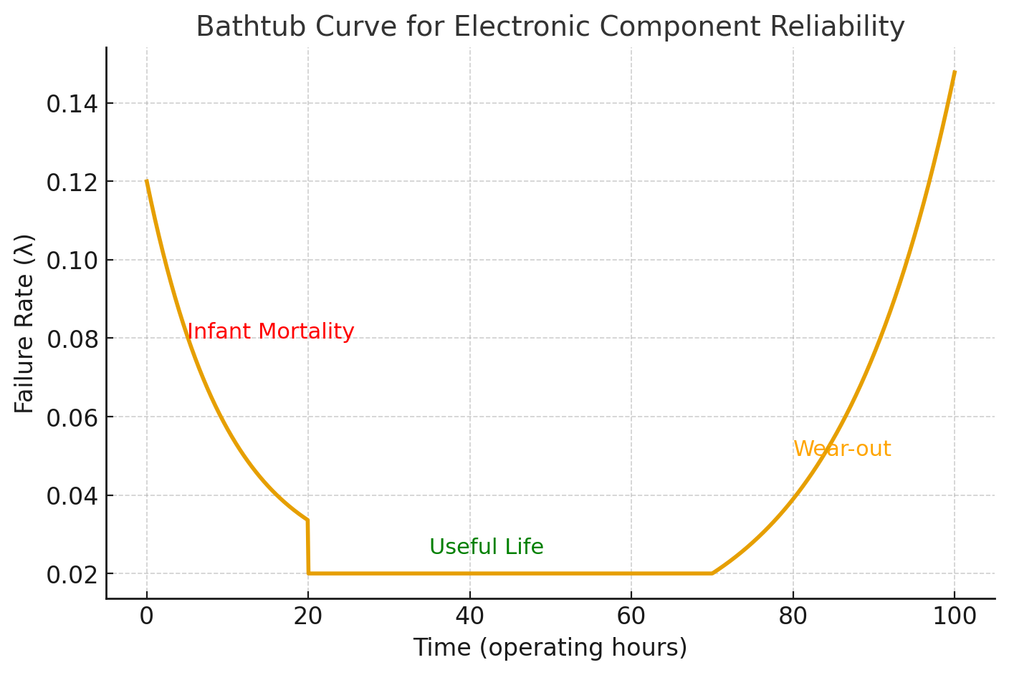
MTTF Intuition

Slide 45
Taxonomy of System Tests
Types of system tests

Slide 46
Regression Tests
In this category, new tests are not designed, instead, test cases are selected from the existing pool and executed
The main idea in regression testing is to verify that no defect has been introduced into the unchanged portion of a system due to changes made elsewhere in the system
During system testing, many defects are revealed and the code is modified to fix those defects
One of four different scenarios can occur for each fix:
The reported defect is fixed
The reported defect could not be fixed inspite of making an effort
The reported defect has been fixed, but something that used to work before has been failing
The reported defect could not be fixed inspite of an effort, and something that used to work before has been failing

Slide 47
Regression Tests
One possibility is to re-execute every test case from version n − 1 to version n before testing anything new
A full test of a system may be prohibitively expensive.
A subset of the test cases is carefully selected from the existing test suite to
maximize the likelihood of uncovering new defects
reduce the cost of testing

Slide 48
Taxonomy of System Tests
Types of system tests

Slide 49
Documentation Tests
Documentation testing means verifying the technical accuracy and readability of the user manuals, tutorials and the on-line help
Documentation testing is performed at three levels:
Read test: In this test a documentation is reviewed for clarity, organization, flow, and accuracy without executing the documented instructions on the system
Hands-on test: Exercise the on-line help and verify the error messages to evaluate their accuracy and usefulness.
Functional test: Follow the instructions embodied in the documentation to verify that the system works as it has been documented.
Notes:
May be only partially automated (i.e. the text describing an API matches the API itself).

Slide 50
Taxonomy of System Tests
Types of system tests

Slide 51
Regulatory Tests
In this category, the final system is shipped to the regulatory bodies in those countries where the product is expected to be marketed
The idea is to obtain compliance marks on the product from various countries
Most of these regulatory bodies issue safety and EMC (electromagnetic compatibility)/ EMI (electromagnetic interference) compliance certificates (emission and immunity)
The regulatory agencies are interested in identifying flaws in software that have potential safety consequences
The safety requirements are primarily based on their own published standards

Slide 52
Software Safety
A hazard is a state of a system or a physical situation which when combined with certain environmental conditions, could lead to an accident or mishap
An accident or mishap is an unintended event or series of events that results in death, injury, illness, damage or loss of property, or harm to the environment
Software safety is defined in terms of hazards
A software in isolation cannot do physical damage. However, a software in the context of a system and an embedding environment could be vulnerable

Slide 53
Software Safety
Examples:
A software module in a database application is not hazardous by itself, but when it is embedded in a missile navigation system, it could be hazardous
If a missile takes a U-turn because of a software error in the navigation system, and destroys the submarine that launched it, then it is not a safe software

Slide 54
Safety Assurance
There are two basic tasks performed by a safety assurance engineering team:
Provide methods for identifying, tracking, evaluating, and eliminating hazards associated with a system
Ensure that safety is embedded into the design and implementation in a timely and cost effective manner, such that the risk created by the user/operator error is minimized

Slide 55
Exploratory Testing

Slide 56

Exploratory Testing (James Bach's definition)
The most advanced and currently 'hot method' is exploratory testing as developed by James Bach and James Whittaker. It is not at all a simple 'ad-hoc' testing where you click around for a while and see what you find.
http://www.satisfice.com/articles/what_is_et.shtml
Notes:
In explorative testing all test activities are done concurrently and not very structured. There is no sequence of planning, test design (and documentation), creating test data, no focus on repeatability etc. There is however a test charter (defines test scope and time).
Exploratory testing is more like exploring a test scope. The intuition of the tester guides him where to look and for what. When issues / defects are found, then the tester usually does a drill-down in this area (heuristic: when you find one bug, there are usually more in the neighborhood). Test charters are intentionally high level and vague in order to give room for free exploration, yet give bounds to the scope so that multiple people will not do the same tests. All charters should have time limits.

Slide 57
Exploratory Testing (James Bach's definition)
informal test design technique where the tester actively controls the design of the tests as those tests are performed and uses information gained while testing to design new and better tests.

Slide 58
Features and Use
When issues / defects are found, then the tester usually does a drill-down in this area (heuristic: when you find one bug, there are usually more in the neighborhood).
Concurrent test design, test execution, test logging and learning
1
3
The intuition of the tester guides him where to look and for what.
2
4
Based on a test charter containing high level test objectives

Slide 59
Features and Use
Popular if there is severe time pressure
Carried out within time-boxes
5
7
Useful where there are few or inadequate specifications
Prepare for / augment or complement other, more formal testing
6
8

Slide 60
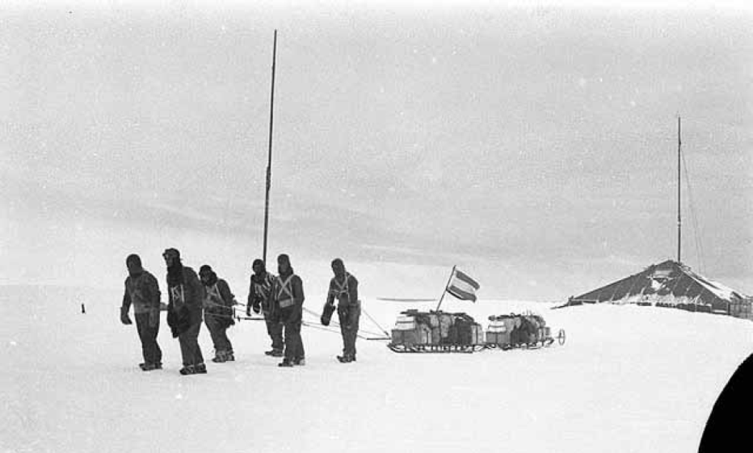
Exploratory Testing Sessions have Charters that define test object (scope), time investment and a test focus in terms of a 'Tour'
'Tours' focus on a specific type of issue
Tours guide the hand of the manual tester, provide strategy and set goals
Follow patterns, find important bugs , …
Notes:
Positioning ET (exploratory testing) vs. Black Box Test Design and automation:
Exploratory and structured methods are complementary.
Use ET (done by developers / POs) to quickly test all kinds of aspects in an efficient way
ET is highly efficient since it basically does not define test cases in the classical sense (only charter and tour). But ET is also of course manual and therefore should not be repeated over and over (like automated tests).
After the code is stable ('new code' tested once), define automated tests with thorough black-box test modeling for the important functions / actions .
ET also blends well with test-driven-development (TDD).
What actually works best has to be learned by experience.

Slide 61


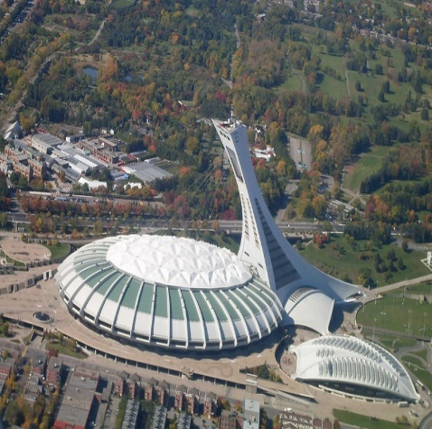
Tour Analogy: A software tester is like a tourist
Can not see everything
Lots of different ways of exploration
Wants to make sure to see the most important things
Focus of testing by tours on important topics for the product with the experience of testers that showed that these tours find many bugs

Slide 62
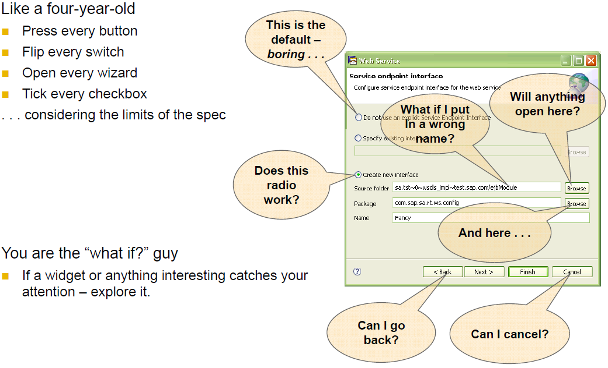
Exploratory Testing – TOUR Example
Tour: "Like a four-year old …" (*)
(*) You can make up your own tours and names
Notes:
Exploratory testing – example
The GOOGL MAP example:
Source: https://www.utest.com/webinars/exploratory-software-testing
What has been the tour?
Some path / some data in your software is more important than others.
For the MAP application the national public places are quite important .
So the test tour has been : check the national buildings and public places

Slide 63
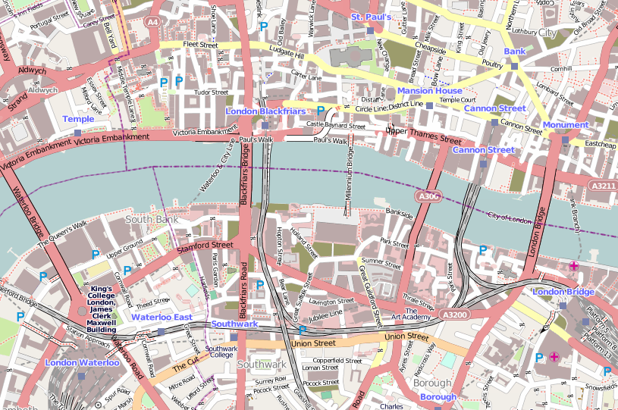
Landmark Tour
Pick the most important features (landmarks) of your application and execute them in different orders.

Slide 64

FedEx Tour
Focus on data. Create it, change it, delete it and check if it’s saved and transported correctly.

Slide 65
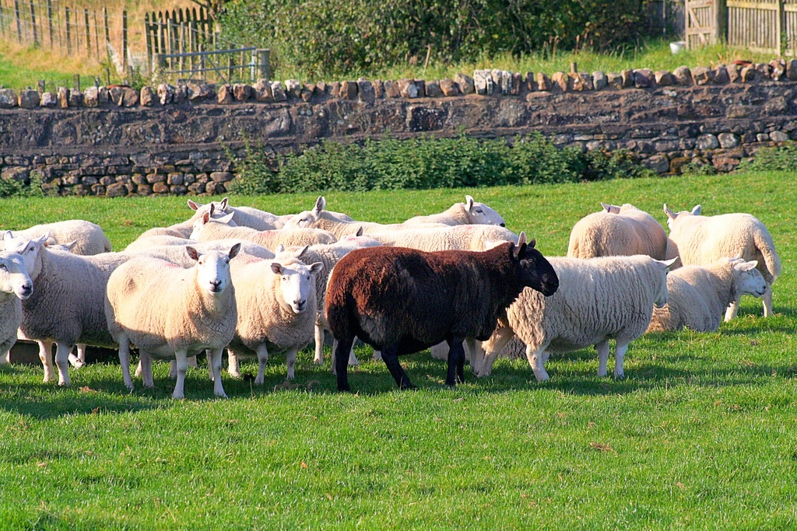
Anti Social Tour
Be different…

Slide 66
Repeat every step of a scenario twice or as often as you want.
Especially steps which manipulate data usually contain bugs which appear after lots of repetition.
Same for error messages. Error handling code usually does not get as much attention from developers than other code.
If you provoked an error message try to replicate the same error again and again.
Obsessive Compulsive Tour

Slide 67
Idea: Most applications perform tasks even when the user is not interacting with them.
Backup jobs are running, data gets archived, clients might poll a backend server.
The idea of the after-hours tour is to check the application for such tasks and make sure that these pieces of code which might not be directly connected to a feature are also getting tested.
After-Hours Tour

Slide 68
Idea: The TOGOF tour focuses on testing what happens if two or more instances of the same application are running simultaneously.
Start multiple instances, put them through the paces by causing each application to manipulate the memory and the disk.
Come up with scenarios were two or more instances try to manipulate the same resource or let them all do the same thing at once.
TOGOF Test one get one free Tour

Slide 69
Idea: Large long running projects usually have tons of legacy code.
The idea behind the museum tour is to have a look at these pieces of code.
First find out which code has not been changed for a long time by running the necessary reports then use those information to test the features which execute this code.
Even if your project only contains brand new code, make sure to check whether it interacts with older code via APIs etc. and make sure the interaction does not lead to bugs.
Museum Tour

Slide 70
Idea: A lot of bugs only happen if the software has been running for a long time, for example such bugs could be memory leaks.
The task of the All-nighter tour is to simulate this scenario.
In order to simulate long running applications, etc. it is often necessary to build some sort of test infrastructure and get computers which are not turned off overnight.
All-Nighter Tour

Slide 71
Idea: In this tour you use the cancel button A LOT! Execute every kind of long running job, process and make sure that it is possible to cancel it.
Examples for such scenarios are file transfers, batch jobs, complicated searches, etc. Start such features and use the cancel button or hit the Escape key.
Rained-out Tour

Slide 72
Idea: Use the product documentation as a guide through the application.
Re-use HowTo's and tutorials.
Try use cases/details described in educational documents (BC400/401, ...).
After the tests the documentation should not contain any mistakes and all features should work exactly as documented.
Guidebook Tour (F1 Tour)

Slide 73
Idea: DO NOT exactly exercise the features which are in scope of the test case. Instead test the nearest neighbor.
For example if the test case tells you to use the log in language German use English instead. If you should create a user with a German Address create one with an English address.
This variation makes sure that test cases which have successfully been executed for a long time suddenly might find bugs again. It is a cheap way to introduce variations into old test cases.
Supporting Actor Tour

Slide 74
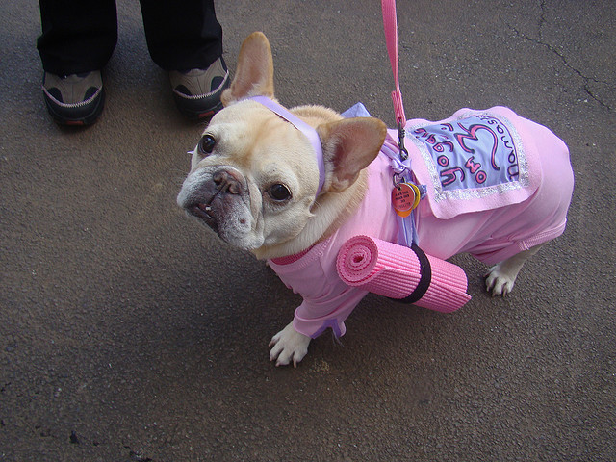
Super Model Tour
It‘s all about the look… ☺
Notes:
More about how it looks and feels rather than actual correctness. Is it consistent, aligned, clean, trust inspiring etc.

Slide 75
Exploratory – All Standard Tours
Business District Guidebook Tour (F1 Tour) Money Tour Landmark Tour Intellectual Tour FedEx Tour After-Hours-Tour Garbage Collector's Tour | Tourist District Collector's Tour Lonely Businessman Tour Supermodel Tour TOGOF Tour (TestOneGetOneFree) Scottish Pub Tour | Seedy District Saboteur Antisocial Tour Opposite Crime Spree Wrong Turn Obsessive-Compulsive
Historical District Bad-Neighborhood Museum Tour Prior Version Tour | Entertainment District Supporting Actor Tour Back Alley Tour All-Nighter Tour | Hotel District Rained-Out Tour Couch Potato Tour
James Whittaker
Exploratory Software Testing: Tips, Tricks, Tours, and Techniques to Guide Test Design
Addison Wesley Pub Co Inc, 2009
Notes:
Exploratory testing – Tours
Since the tour descriptions are not bound to any product type, technology or development process they even facilitate cross team communication. However, this works only if everybody fully understands each testing tour and which test approach and focus it represents. All tours are described in detail in James Whittaker’s book "Exploratory Software Tours". But most teams do not have the time to go through the book so I decided to provide this little cheatsheet which describes the core idea of each tour and gives a simple example. Be aware that tours are not designed for manual testing only, on the contrary, they offer great inspiration for developers who are writing automated tests of any scale, as well.
BUSINESS DISTRICT
Guidebook Tour (F1 Tour)
Idea: Use the product documentation as a guide through the application. Re-use HowTo's and tutorials. Try use cases/details described in educational documents (BC400/401, ...). After the tests the documentation should not contain any mistakes and all features should work exactly as documented.
Money Tour
Idea: The money tour tests the features which were the main reasons that the customer bought the software in the first place. Usually these are the features which salespersons show when they try to sell the product. Let a salesperson do a product demo for you in order to find out what "money" features your application has.
Landmark Tour
Idea: Pick the most important features of your application and execute them in different orders. The landmark tour is not meant to be just testing the main functionality. This can and should be done by automated test. What an automated test cannot do is to put many features into all possible sequence orders. The goal of the landmark tour is thereby to test that the main features of an application work together in different orders.
Intellectual Tour
Idea: The intellectual tour is used to ask the software really hard questions. James Whittaker gives some questions as guidance for the intellectual tour: "How do we make the software work as hard as possible? Which features will stretch it to its limits? What inputs and data will cause it to perform the most processing? Which inputs might fool its error-checking routines? Which inputs and internal data will stress its capability to produce any specific output?"
Fedex Tour
Idea: The FedEx tour is used to identify and follow specific pieces of data through the various part of the software which you are testing. The testers check that all parts properly interact with the data.
After-Hours Tour
Idea: Most applications perform tasks even when the user is not interacting with them. Backup jobs are running, data gets archived, clients might poll a backend server. The idea of the after-hours tour is to check the application for such tasks and make sure that these pieces of code which might not be directly connected to a feature are also getting tested.
Garbage Collector‘s Tour
Idea: Garbage-men go street by street, house by house. They stay only a few moments but they crisscross the neighborhood in a methodical manner. For software testing this means to spot-check each and every capability/feature/module/... within a defined scope.
TOURIST DISTRICT
Collector's Tour
Idea: Similar to a tourist traveling across the country collecting post cards from each state/large city, the idea behind the collectors tour is that a tester tests a specific feature by collecting all outputs possible. The focus of this tour is completeness.
Lonely Businessman Tour
Idea: Businessman travel a lot. The focus of this tour is to "travel" as far through the application as possible. Choose long paths over short paths. Which paths through the application need the most clicks, require the most screens?
Supermodel Tour
Idea: The supermodel tour tests only the UI and not the logic behind it. The tester picks a feature and makes sure it follows the UI guidelines, all icons are correct, no texts contain spelling mistakes, etc. In order to make it easier to check whether features follow the UI guidelines, it is a good idea to create short checklists together with the responsible UX person.
TOGOF Test one get one free Tour
Idea: The TOGOF tour focuses on testing what happens if two or more instances of the same application are running simultaneously. Start multiple instances, put them through the paces by causing each application to manipulate the memory and the disk. Come up with scenarios were two or more instances try to manipulate the same resource or let them all do the same thing at once.
Scottish Pub Tour
Idea: Large cities have a large amount of pubs. Some are busy all the time some or not. In order to find the busy, popular ones you usually need a guide to tell you where to look. Transfer this idea to software products. Large and complex products have a lot of features. However, testers usually have a hard time finding the ones which are used a lot. The idea behind the tour is that the testers actively try to find these features by talking with single user, user groups in order to find features which might have already not been tested.
SEEDY DISTRICT
Saboteur Tour
Idea: Test the software in the most destructive way possible: undermine the application when/how ever possible while focusing on the resources which the application needs, remove/restrict resources (block file access, restrict available memory/disk space), change environmental conditions (disconnect network connections,...). Focus only on needed resources.
Antisocial Tour
Idea: Always do the opposite of what the others are doing. Use invalid inputs instead of valid ones. Execute features in the wrong order. Always think about the opposites e.g. if valid input is a number enter a character, if valid input is a picture file use a word file and so on. Testers should expect to see the a lot of error messages when they perform this tour.
Obsessive Compulsive Tour
Idea: Repeat every step of a scenario twice or as often as you want. Especially steps which manipulate data usually contain bugs which appear after lots of repetition. Same for error messages. Error handling code usually does not get as much attention from developers than other code. If you provoked an error message try to replicate the same error again and again.
HISTORICAL DISTRICT
Bad Neighborhood Tour
Idea: All software products have parts which contain a lot of bugs. Of course, you do not know which parts this will be in advance. However, after testing for some time you should be able to compile a list with locations were these "bad neighborhoods" are located. Now, you can specifically focus on those areas and run tours such as the garbage collector tour to make it bug free, again.
Museum Tour
Idea: Large long running projects usually have tons of legacy code. The idea behind the museum tour is to have a look at these pieces of code. First find out which code has not been changed for a long time by running the necessary reports then use those information to test the features which execute this code. Even if your project only contains brand new code, make sure to check whether it interacts with older code via APIs etc. and make sure the interaction does not lead to bugs.
Prior Version Tour
Idea: Before a new product version gets released make sure that the all test cases for the old version also are getting run for the new version. Verify that no functionality got lost in the new version.
ENTERTAINMENT DISTRICT
Supporting Actor Tour
Idea: DO NOT exactly exercise the features which are in scope of the test case. Instead test the nearest neighbor. For example if the test case tells you to use the log in language German use English instead. If you should create a user with a German Address create one with an English address. This variation makes sure that test cases which have successfully been executed for a long time suddenly might find bugs again. It is a cheap way to introduce variations into old test cases.
Back-alley Tour
Idea: The back alley tour is run for features which users hardly use during their daily work. This does not mean that these features are not important, quite the contrary, for example hopefully users never have to use features like data recovery. However, if they need them they have to work properly. Other examples for rarely used features are preference dialogs or features which only appear when the user starts the application for the first time.
All-Nighter Tour
Idea: A lot of bugs only happen if the software has been running for a long time, for example such bugs could be memory leaks. The task of the All-nighter tour is to simulate this scenario. In order to simulate long running applications, etc it is often necessary to build some sort of test infrastructure and get computers which are not turned off overnight.
HOTEL DISTRICT
Rained-Out Tour
Idea: In this tour you use the cancel button A LOT! Execute every kind of long running job, process and make sure that it is possible to cancel it. Examples for such scenarios are file transfers, batch jobs, complicated searches, etc. Start such features and use the cancel button or hit the Escape key.
Couch Potato Tour
Idea: Persons who are sitting on the coach, watching TV, eating potato chips are usually called coach potatoes. The idea behind this tour is to pick a feature and try to test it with as little work as possible. Some examples: test a user form and only enter the data which is absolutely necessary, navigate the application by only using the mouse. One idea of this tour is to ensure that the default cases are getting tested.
Source: Exploratory Testing Tours Cheatsheet Posted by Thomas Alexander Ritter on Oct 18, 2010 3:52:17 PM

Slide 76
Exploratory Testing
The good news: You can start right away…
Test the software of someone else …
Good tours to start with …
'Supermodel' when you have UI
'Garbage Collector' since it covers much
'AntiSocial' as a negative testing approach
'FedEx' follow the data
Look at the 'tour cheat sheet’, (in supplemental materials)
Notes:
Positioning ET (exploratory testing) vs. Black Box Test Design and automation:
Exploratory and structured methods are complementary.
Use ET (done by developers / POs) to quickly test all kinds of aspects in an efficient way
ET is highly efficient since it basically does not define test cases in the classical sense (only charter and tour). But ET is also of course manual and therefore should not be repeated over and over (like automated tests).
After the code is stable ('new code' tested once), define automated tests with thorough black-box test modeling for the important functions / actions .
ET also blends well with test-driven-development (TDD).
What actually works best has to be learned by experience.

Slide 77


Readings , Assignments, Project Tasks
Read:
Chapters 16, 17, 18, 19, 20 of the textbook.
Systems Testing Taxonomy (Supplemental Materials).
Exploratory Testing Tours (Supplemental Materials).
Assignments & Project Tasks:
Assignment 3 is due next Friday.

